Slide 1
Customized Tour Recommendations in Urban Areas
Date : 2014/11/20
Author: Aristdes Gionis, Konstaninos Pelechrinis, Theodoros Lappas, Evimaria Terzi
Source: ACM WSDM’14
Advisor: Jia-ling Koh
Speaker: Han, Wang

Slide 2
Outline
Introduction
Probleem Definition
Algorithms
Experiments
Conclusion

Slide 3
Introduction
Motivation:
There are many intelligent services to enhance the quality of urban life.
General location-based network recommendation systems focus on venues or location-based activities, and evaluate each venue independently.

Slide 4
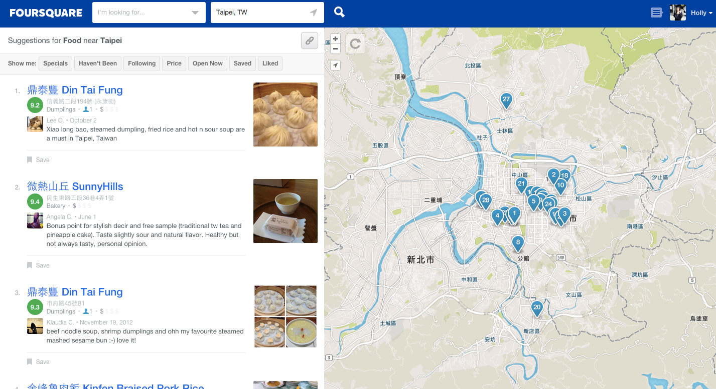
Introduction
Drawback: evaluate venues in group, thematic and spatial constraints

Slide 5
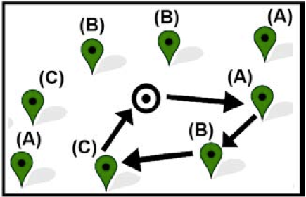
Introduction
Goal:
Utilize contextual information to provide customized “tour” recommendations for advanced urban navigation.
Improvement:(Framework of recommendation)
Different “type” and “order”.
Distance budget constraints.
Satisfaction of each venue.
Park
Restaurant
Drink

Slide 6
Outline
Introduction
Probleem Definition
Algorithms
Experiments
Conclusion

Slide 7
Problem Definition
Venues: V={v1, v2,……vn}
Types: T={T1,……Tm}
Tour R = <v1, v3, v5>
R(i): i-th venue in the tour
Order Constraints: Ti ≺π Tj (visit Ti before Tj)
Budget Constraints: distance D
Multiplicity bounds: B={(Li,Uj)}
*User Satisfaction

Slide 8
Problem Definition
User Satisfaction: (F(R))
additive satisfaction function Add : (maximize quality)
benefit associated with venues: b(v)
Add(R) =
coverage satisfaction function Cov : (maximize diverse route)
attractions near venues: S(v)
Cov(R) =
Define all of these as “TOURREC” problem.

Slide 9
Problem Definition
ADDITIVETOUR problem
- TSP(Traveling Salesman Problem)
- NP-hard
- TSP has a solution if only if ADDITIVETOUR has a solution
COVERINGTOUR problem
-NP-hard
-Maximum Coverage Problem

Slide 10
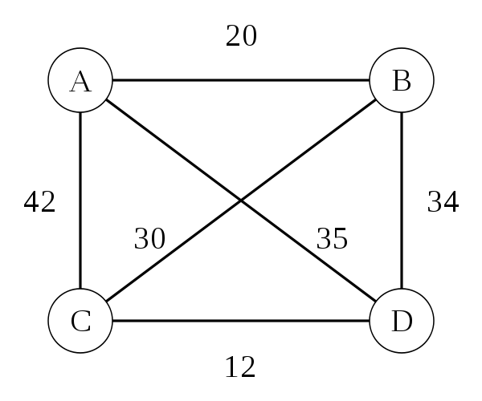
Problem Definition
TSP(Traveling Salesman Problem)
-dynamic programming
-O(n²2^{n})
-NP-hard problem in combinatorial optimization
-G(i,S) =min{Dij +G(j, S-{j})}
2
4
3
3
3
1

Slide 11
Outline
Introduction
Probleem Definition
Algorithms
Experiments
Conclusion

Slide 12
Algorithms
Algorithm for ADDITIVETOUR
Condition: (1) total order π (2)one venue from every type(Li = Uj = 1)
-define B(v, d) as the maximum value of Add function
-dynamic programming table dimension = (n+2)*D
-Time: O(n²D) (worse case)
-“Rel-DP” algorithm
B(v, d) = max{B(v’, d-Dist(v, v’)) + b(v)}

Slide 13
Algorithms
Algorithm for COVERINGTOUR
Condition: (1) total order π (2)one venue from every type(Li = Uj = 1)
-visit one venue for each type
-Time: O(n²D) (worse case)
-“Cover-DP” algorithm
C(v, d) = max{C(v’, d-Dist(v', v)) + Cov(v|Rv’,d-Dist(v’,v))}

Slide 14
Algorithms
Speedup:
Fully polynomial-time approximation scheme(FPTAS)
-scale down the input problem —> distances = n(polynomial)
-parameter
-define K =
-Dist(v, v’) =
-dynamic programming table dimension = (n+2)*
-running time:

Slide 15
Algorithms
Extension:
Relaxing total order constraints:
-partial orders of type, super types, type skips
Multiple venues per type
Time budget & venue delays
Multiple transportation types

Slide 16
Outline
Introduction
Probleem Definition
Algorithms
Experiments
Conclusion

Slide 17
Experiments
Dataset: (From Foursquare)
Twitter form 2010/9 ~ 2011/1 related to Foursquare
6,699,516 chek-ins
9 types(Art, Entertainment, Food…..)
three cities (New York, San Francisco, London)
all check-ins within 10-miles from the city center

Slide 18
Experiments
Condition:
(1) Type of “Great Outdoors” —> COVERINGTOUR problem
(2) Compute universal relevance score b(v) for every venue, and the set S(v) for near by activities
(3) Compare with Greedy Algorithm(Rel-Greedy or Cov-Greedy)
(4) Compare based on the solution of Greedy ( Rel-DP(Gr) or Cov- DP(Gr) )

Slide 19
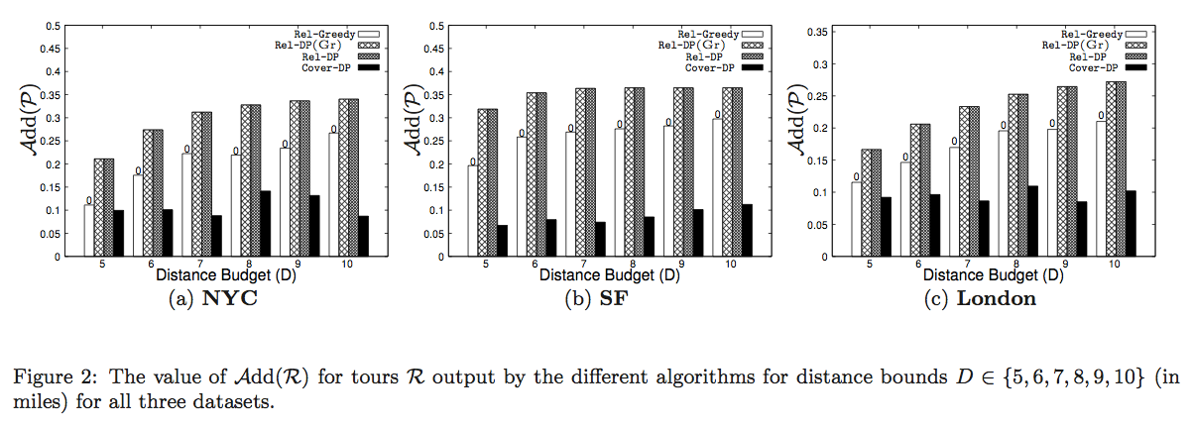
Experiments

Slide 20
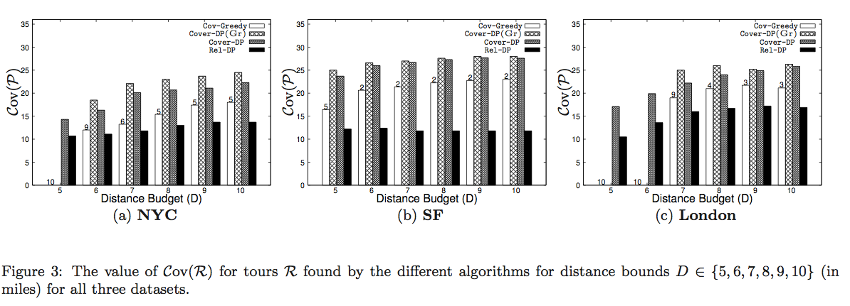
Experiments

Slide 21
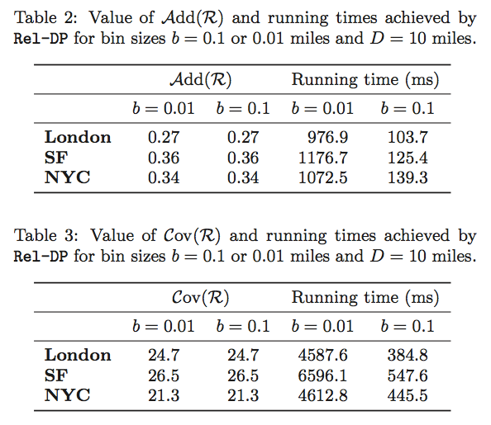
Experiments

Slide 22
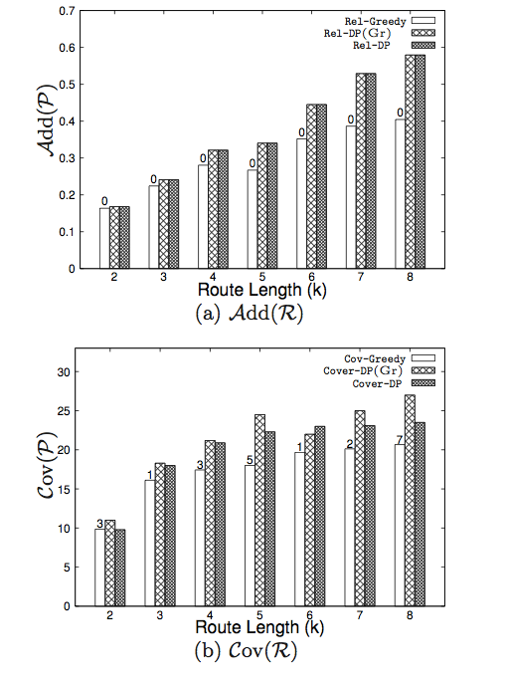
Experiments
Varying the tour size k(venue type)
Set D=6(miles) &
k = {2,3,4,5,6,7,8}(distinct types)
Dataset form NYC

Slide 23
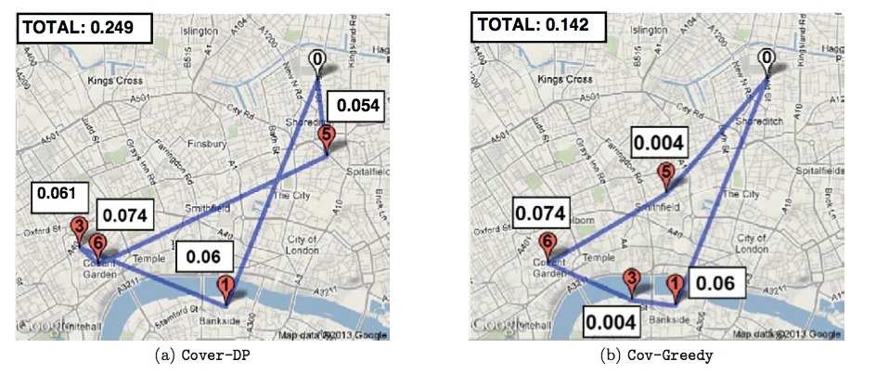
Experiments
Rel-DP
Rel-Greedy

Slide 24
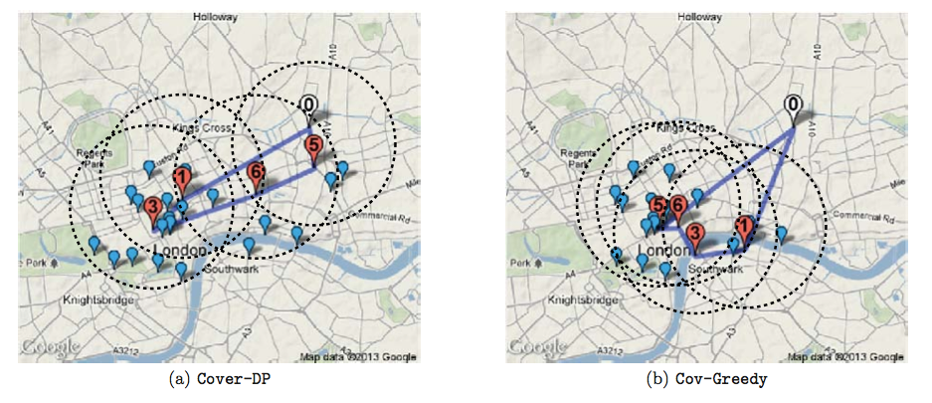
Experiments

Slide 25
Outline
Introduction
Probleem Definition
Algorithms
Experiments
Conclusion

Slide 26
Conclusion
Presented two alternative instantiations of the framework for generating customized tour recommendation.
ADDITIVETOUR assigns a benefit to each location and to retrieves the sequence of venues with maximum total benefit.
COVERINGTOUR is to maximum the total number of attraction covered.
Provide efficient algorithmic solutions.
Demonstrate practical utility of the proposed formulations and algorithm.

